Slide 1
Heating Processes

Slide 2
Kinetic Theory

Slide 3
Learning Intentions
Describe the kinetic particle model of matter.
Recall the states of matter
Understand temperature scales and how to convert between Celsius and Kelvin.
Describe how to record temperature

Slide 4
Kinetic particle Model
The kinetic model of matter states that all matter is made up of particles which are in a constant state of motion.
Since the particles are moving, they must have kinetic energy associated with them.
Particles also have potential energy. This energy is stored in the bonds between particles and the amount of stored energy depends on the distance between the particles.

Slide 5
Assumptions of the kinetic particle Model
All matter is made up of small particles in constant motion (have kinetic energy)
Collisions between particles are perfectly elastic; the total kinetic energy before and after the collision is the same.
Potential energy is stored in the ‘springs’ that connect the particles; potential energy depends on the distance between particles.

Slide 6
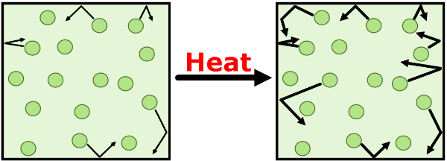
Temperature and Kinetic energy
All particles have energy but the amount of energy varies according to the temperature.
As temperature increases, the kinetic energy of the particles increases.
The temperature of a substance is a measure of the average kinetic energy of the particles.

Slide 7
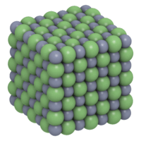
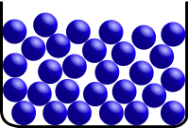
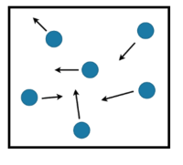
Three main states of Matter: Solids, Liquids and gases
Solids are made up of particles which are tightly packed together. They have a fixed volume, fixed shape and are mostly incompressible.
Liquids are made of particles which are loosely packed together. They do not have a fixed shape; they take on the shape of the container they are in. They do have a fixed volume and are more or less incompressible.
Gases are made up of particles which are free to move. They do not have a fixed shape or volume are compressible.

Slide 8
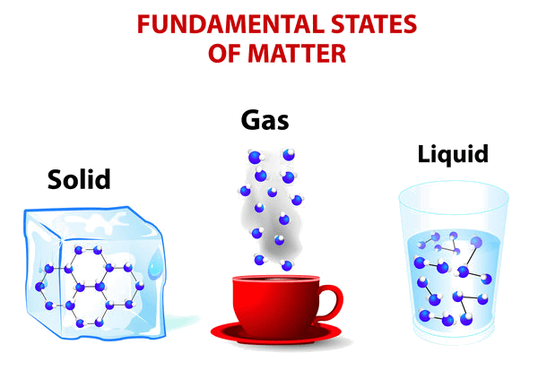
Energy in solids, liquids and gases
Particles in solids have low kinetic energy. The particles are tightly bound, so can’t move much, giving them a smaller kinetic energy.
Particles in liquids have a moderate amount of kinetic energy. This is because the particles can move more, giving them a greater kinetic energy.
Particles in gases have highest kinetic energy as the particles are moving quickly in an ideal gas, there are no intermolecular forces. However, in a real gas there are weak intermolecular forces.

Slide 9
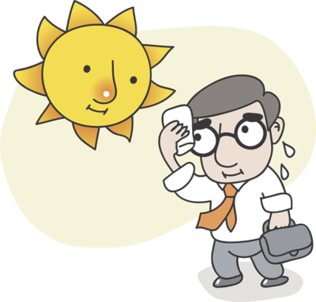
Heat and Temperature
In everyday language we often use heat and temperature interchangeably.
However, in physics these terns have different meanings.
Temperature is the average kinetic energy of particles in a body.
Heat is thermal energy which is transferred from one body to another due to temperature difference. Adding heat energy to a body causes the particles to vibrate faster, increasing the temperature of the body.

Slide 10
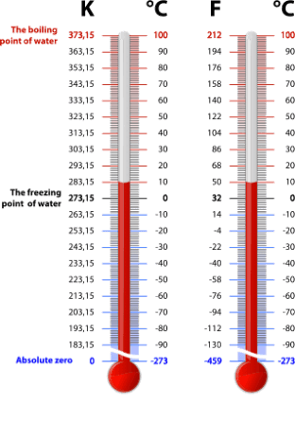
Scales of measuring temperature
These are the Kelvin scale, Celsius scale and Fahrenheit scale.
The Celsius scale has units ᵒC. The freezing point of water is 0ᵒC and the boiling point of water is 100ᵒC. This is the scale we use most often in our everyday lives.
The Kelvin scale has units K. At absolute zero (0 K), atoms stop moving, because they have no kinetic energy. An interval of 1 K is equal to an interval of 1ᵒC. A temperature of 0 K is equivalent to −273.15ᵒC.
The Fahrenheit scale is another way of measuring temperature. The USA is the only major country which uses it, and the Fahrenheit scale is not used in scientific writing.

Slide 11
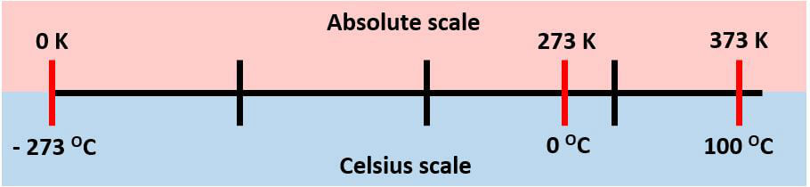
Kelvin scale (absolute scale) and Celsius scale
In both the absolute scale and the Celsius scale, one degree is the same change in temperature.
The Celsius scale is based on properties of water, whilst the absolute scale is based on energy of the particles.

Slide 12
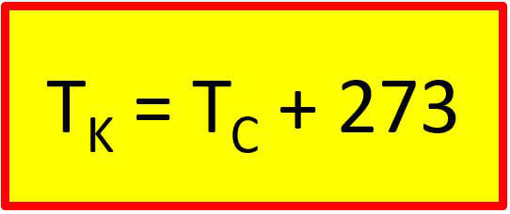
Converting Celsius to Kelvin
Where T_{K}​ is the temperature in Kelvin and T_{C}​ is the temperature in Celsius.
For example, what temperature in Kelvin does water boil at?
T_{C}​=100ᵒC
T_{K​}=100+273
T_{K}​=373 K

Slide 13
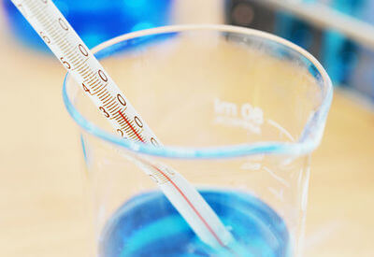
Measuring temperature
Temperature can be measured using various measuring devices.
In the lab you commonly will use an alcohol thermometer or digital thermometer. It is important that you know how to use it correctly and how to work out the measurement uncertainty (absolute and percentage).

Slide 14

Thermometer
A thermometer is filled with red coloured alcohol that expands as it gets hotter.
The level this red fluid reaches gives you the temperature.
It is measured in degrees Celsius (ᵒC).

Slide 15
Temperature Uncertainty
When we are collecting data, every measurement has an intrinsic limit to the number of digits that can be recorded, called the Limit of Reading.
We can't measure to less decimal places, so the measurement could potentially vary from the reading by the value of the limit of reading.
For example, when using an electronic thermometer, it commonly measures to the nearest 0.1ᵒC.
To show that a reading is accurate to within 0.1ᵒC, we use the ± symbol. For example, a reading could be 36.5 ± 0.1ᵒC.
The range is from (36.5−0.1) to (36.5+0.1) ᵒC.
This means the temperature is between 36.4 and 36.6ᵒC.

Slide 16
Questions
Nelson 1&2 Set 1.1 p 9
Nelson 1&2 Set 1.2 p 13

Slide 17
Specific & Latent Heat

Slide 18
Learning Intentions
Define specific heat capacity.
Explain the concept of proportionality in the context of specific heat.
Interpret tabulated and graphical data of heat added to a substance and its subsequent temperature change.
Solve problems involving specific heat capacity.
Recall the 3 main states of matter and he processes involved in changing state.
Explain why the temperature of the system remains the same during the process of state change.
Applying understanding of internal energy and the kinetic particle model of matter to describe the changes of state,
Define specific latent heat.
Solve problems involving specific latent heat.

Slide 19
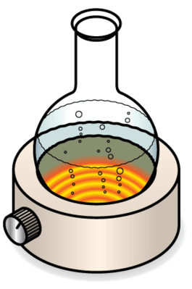
What is specific heat Capacity?
The specific heat capacity of a substance is the energy required to raise the temperature of a unit mass of it by a degree.
The SI unit of specific heat capacity is joule per kilogram per Kelvin (J kg⁻¹K⁻¹) or joule per kilogram per degree Celsius (J kg^{−1∘}C⁻¹).
For practical measurements in the lab, we often use units of joules per gram per degree Celsius (J g^{−1∘}C⁻¹).
This is only valid when there is no phase change taking place. The specific heat capacity is different for every substance, because it is related to the physical and chemical structure.

Slide 20
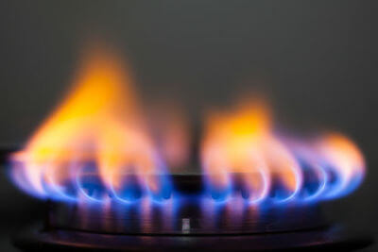
If one substance has a low specific heat capacity, it will heat up or cool down more quickly than a substance with a high specific heat capacity.
This is because less energy is needed for the same change in temperature.

Slide 21
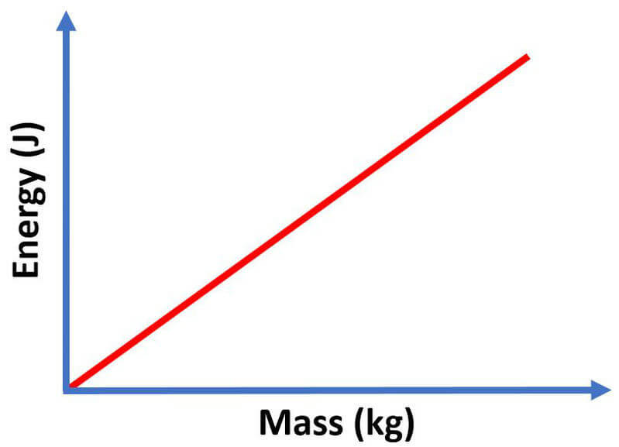
Specific Heat capacity and Mass
If you double the mass, you will need twice as much energy to heat the substance by one degree.
If you triple the mass, you will need three times as much energy to raise the temperature by one degree and so on.
As mass increases, the energy required to heat the substance by one degree increases proportionally.

Slide 22
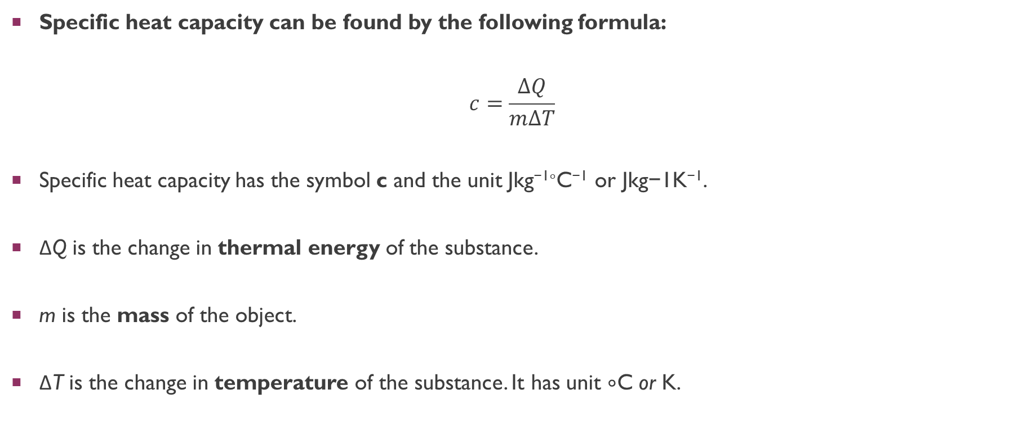
Specific Heat Capacity Equation
Specific heat capacity can be found by the following formula:
$$c=\frac{∆Q}{m∆T}$$
Specific heat capacity has the symbol c and the unit Jkg^{−1∘}C⁻¹ or Jkg−1K⁻¹.
ΔQ is the change in thermal energy of the substance.
m is the mass of the object.
ΔT is the change in temperature of the substance. It has unit ∘C or K.

Slide 23
We can rearrange this formula to find:
ΔQ=mcΔT
ΔQ is the change in heat of the substance. It is the amount of thermal energy that is added to or removed from the substance.
m is the mass of the object. It has units of kg (kilograms), so be careful when you are given the mass in grams!
ΔT is the change in temperature of the substance. It has unit ∘C or K.

Slide 24
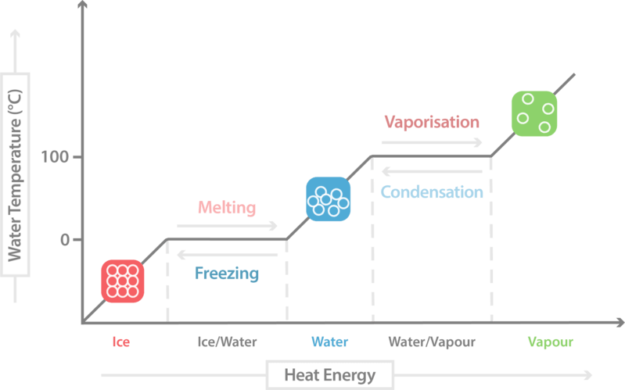
Heating Curve
A heating curve shows the temperature of a substance as it is heated over time.
The temperature generally increases steadily as energy is added to the system, however, during a change of state, the energy is used to break bonds, so a temperature rise is not observed.
The graph below shows an ideal heating curve:

Slide 25
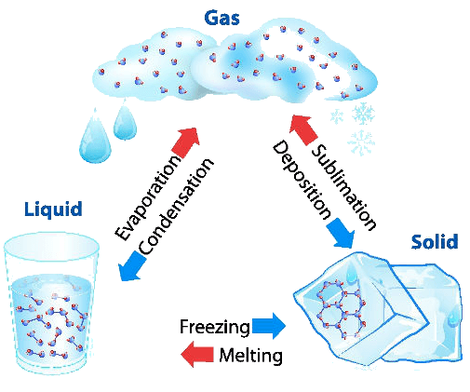
Changing state

Slide 26
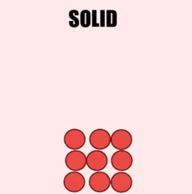
Adding Heat Energy
When heat energy is added to a substance, it causes the particles to move faster and spread out.
This causes the substance to change from solid to liquid, then from liquid to gas.

Slide 27
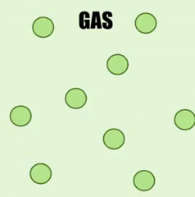
Removing Heat energy
When heat energy is removed from a substance, it causes the particles to move slower and stay in a smaller area.
This causes the substance to change from gas to liquid, then from liquid to solid.

Slide 28
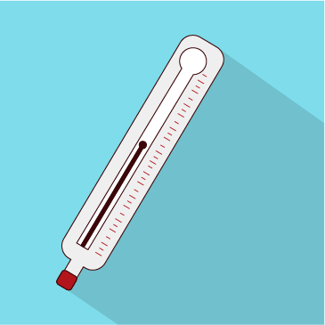
Temperature change during phase change
The temperature of a system remains the same during the process of state change.
The energy being added to or removed from the system (latent heat) is being used to break or form intermolecular bonds. The kinetic energy of the particles does not change, so the temperature does not change.

Slide 29
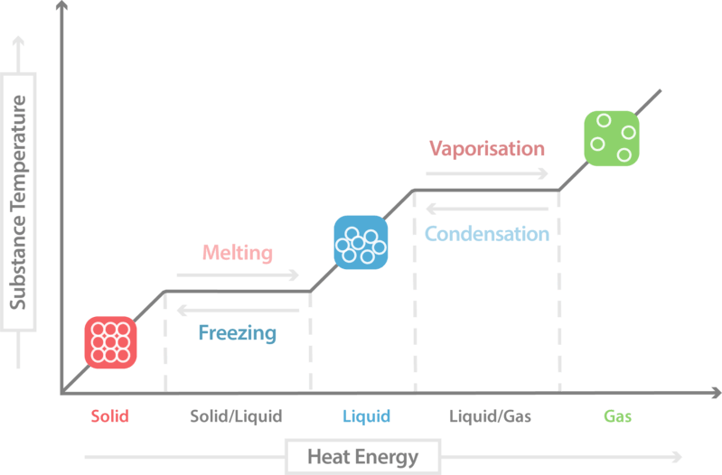
Latent heat
Energy added during a state change is called the latent heat.
The specific latent heat of fusion is the energy needed to change 1 kg of a substance from solid to liquid.
The specific latent heat of vaporisation is the energy needed to change 1 kg of a substance from liquid to gas.

Slide 30
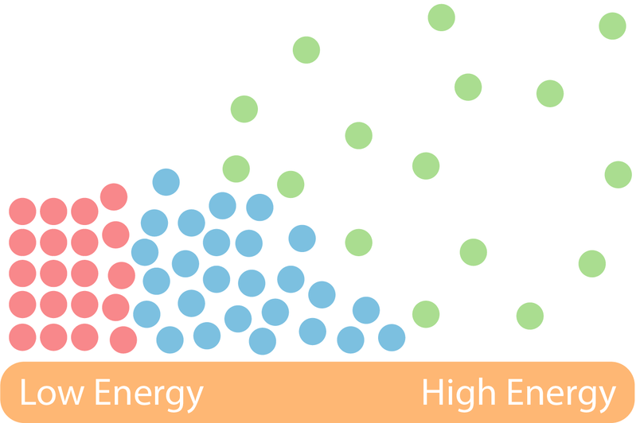
Latent heat and energy
The latent heat does not affect the kinetic energy of the particles within the substance.
It only effects the potential energy of the particles in the substance. This is because the heat added to the substance pulls the particles apart.
This means that during a state change the internal energy of the substance increases but the temperature remains constant.

Slide 31
Questions
Nelson 1&2 Set 1.3 p 20
Nelson 1&2 Set 1.4 p 30

Slide 32
Convection, Conduction & Radiation

Slide 33
Learning Intentions
Describe the different mechanisms for heat transfer.
Describe what is required for conduction to occur.
Explain how conduction relates to the particles in a substance.
Describe how a convection current is formed.
Explain how a convection current transfers heat throughout a space.
Describe how radiation transfers heat.
Identify factors that affect the absorption of heat by radiation.
Explain the process in which thermal energy is transferred between two systems until thermal equilibrium is achieved and recognise this as the zeroth law of thermodynamics.
Solve problems involving specific heat capacity, specific latent heat and thermal equilibrium.
Explain that energy transfer and transformations in mechanical systems always result in some heat loss to the environment, so that the amount of useable energy is reduced.
Define efficiency.
Solve problems involving finding the efficiency of heat transfers.

Slide 34
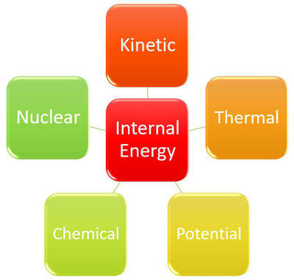
Internal Energy
Internal energy is the sum of the energy possessed by the particles in an object or system.
Internal energy can include kinetic, potential, chemical, nuclear as well as thermal energy.

Slide 35
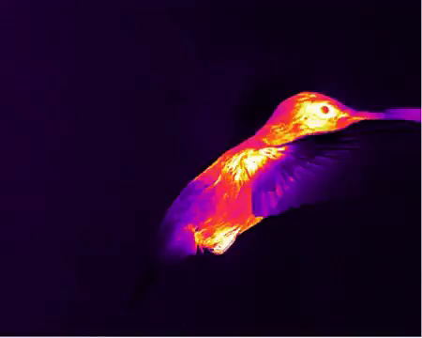
Thermal Energy
Thermal energy is a type of kinetic energy.
Kinetic energy refers to the energy of any object in motion.
Thermal energy is a type of internal energy. It is possessed by an object or system due to the movement of particles within the object or system.
Thermal energy can be transferred from one object or system to another as heat.

Slide 36

Heat and Temperature
It turns out that these are actually two different concepts.
Heat is a type of energy. It is the transfer of the thermal energy of particles from one object or system to another. It is measured in joules (J).
Temperature is the average kinetic energy of the particles in a substance. It is measured in degrees Celsius (∘C), degrees Fahrenheit (∘F) or Kelvin (K).

Slide 37
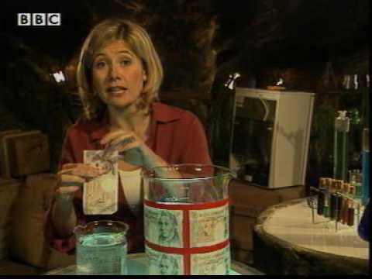

Slide 38

Types of Heat Transfer
There are three types of heat transfer:
Conduction
Convection
Radiation

Slide 39

Conduction
Conduction only occurs between two objects which are in direct contact. This means that the objects have to be touching.

Slide 40
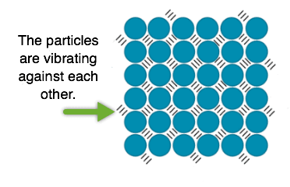
Conduction occurs because of particles vibrating within objects.
These particles are always vibrating. However, they vibrate faster in hotter objects.

Slide 41
When a hot object is in contact with a cold object, the quickly vibrating particles in the hot object will bump into the slower vibrating particles in the cold object.
This causes the particles in the cold object to vibrate faster, increasing the temperature of the object.

Slide 42

Convection
The second method of heat transfer is convection.
Objects do not need to be in contact for this type of heat transfer.
Convection occurs via fluids. Fluids is a term which includes both gases and liquids.

Slide 43
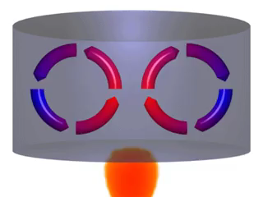
First, one part of the fluid is heated, causing the particles to move apart.
This makes this part of the fluid less dense than the surrounding fluid, causing it to rise.
Cool fluid moves into the space freed up by the less dense part of the fluid. This then gets heated and rises.

Slide 44
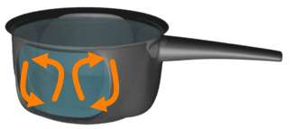
The heated fluid cools down as it moves away from the heat source.
This causes it to become more dense and sink again.
The fluid can then be heated again, continuing the cycle.
This movement of fluid is called a convection current.

Slide 45

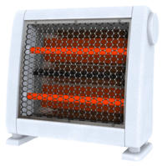
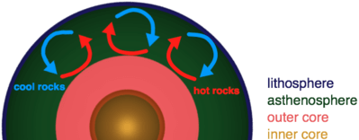
Convection examples
Convection occurs when you heat a pot of water on the stove. This is because only the water near the burner is heated.
Convection also occurs in a room with a heater or fireplace in it. This is what causes the whole room to warm up instead of just the area next to the heater.
There is also convection in the mantle (asthenosphere), which causes the movement of the tectonic plates.

Slide 46
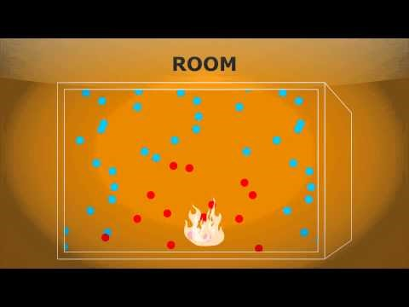
Convection Currents

Slide 47

Radiation
Radiation is the final method of heat transfer.
Every object radiates heat. This heat is transmitted as invisible waves which move at the speed of light!
Radiation transfers heat by waves, not particles like conduction or convection. This means that it can travel through the vacuum of space!
In physics terms, we say that radiation does not need to travel through a medium to transfer heat.

Slide 48
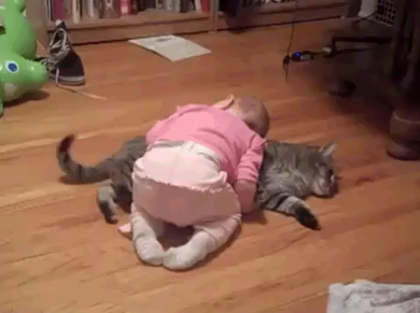
Radiation Examples
Every object radiates heat, even if we can't feel it.
You are radiating heat right now!
Hotter objects radiate more heat.
Some examples of objects which radiate heat are the Sun, a fire, your pet cat.... the list goes on and on!

Slide 49

Absorbing Radiation
All objects emit radiation, but radiation can also be absorbed.
Different objects can absorb different amounts of radiation. The amount of radiation that can be absorbed depends on the material and colour of the object.

Slide 50
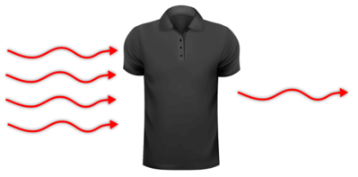
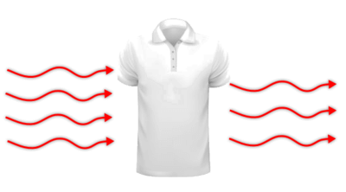
Light surfaces or Dark Surfaces
Dark surfaces absorb a lot of radiation. This means that they heat up much faster than light surfaces.
Light surfaces do not absorb most radiation. Instead they reflect most of it, which means that they stay cool.

Slide 51
Clear objects
Clear objects, like glass, do not reflect or absorb heat radiation. Instead they transmit the radiation. This means that radiation passes through the object.
This is how we can feel heat from the Sun through a window.

Slide 52
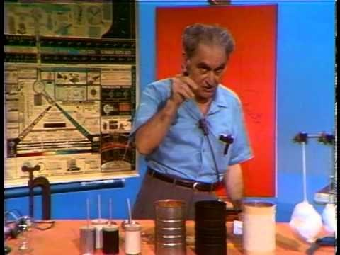

Slide 53
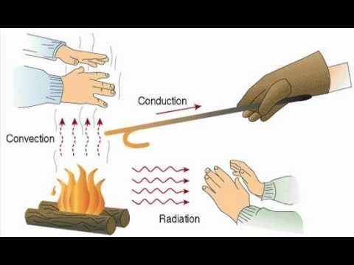

Slide 54
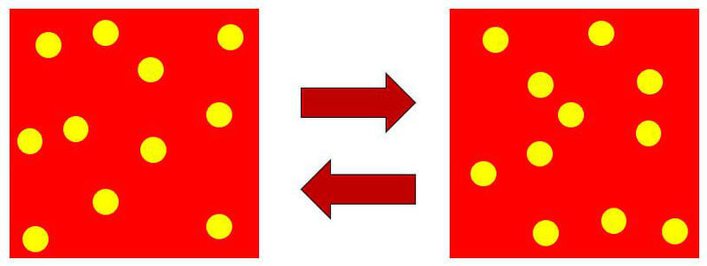
Thermal equilibrium
Thermal equilibrium is defined as the condition of a system in which there is no net exchange of thermal energy between any of its components, i.e. the components have the same temperature and the average kinetic energy of their particles is equal; this relates to the zeroth law of thermodynamics.

Slide 55
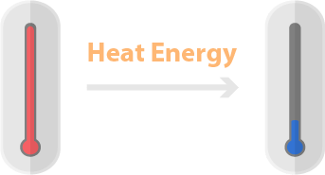
Zeroth Law of Thermodynamics
The zeroth law of thermodynamics states that there will be the transfer of energy from a system with higher temperature to a system with lower temperature until thermal equilibrium is reached.
In simple terms, heat moves from a hotter object to a cooler one until they reach the same temperature!

Slide 56
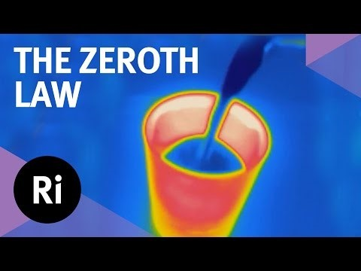

Slide 57
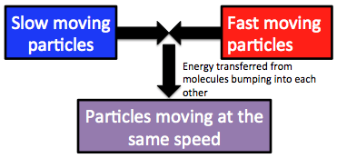
When two substances with different temperatures are brought into contact, heat transfer will occur.
One substance will lose heat and the other substance will gain the same amount of heat until the two substances are the same temperature.
There are still collisions between particles of the two substances which have reached thermal equilibrium. However, there is no net energy transfer, so the temperatures of the substances do not change.

Slide 58
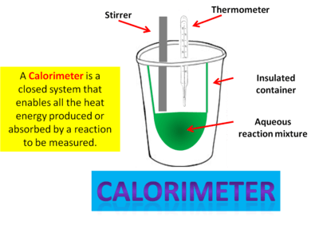
Calorimetry Calculations
You will be expected to solve problems using specific heat capacity, specific latent heat and thermal equilibrium.
These problems will involve mixing a warmer substance with a colder substance.
Assuming the law of conservation of energy, the energy lost by the warmer system must equal the energy gained by the cooler system, assuming no losses to the environment.
You may do some experiments using calorimeters to try and minimise environmental losses and test these calculations.

Slide 59
Calorimetry calculation example
How much ice at −10.0∘C must be added to 4.00 kg of water at 20.0∘C to cause the resulting mixture to reach thermal equilibrium at 5.0∘C? Assume no energy transfer to the surrounding environment, so that energy transfer occurs only between the water and ice.
Specific heat capacity of water (c)=4.19 kJkg^{−1∘}C⁻¹
Law of conservation of energy leads to the energy gained by the ice must equal the energy lost by the water.
Energy lost by the water cooling(Q_{water}​) =mcΔT
ΔT=20−5
Q_{water}​=4.00×4.19×15
Q_{water}​=251.4 kJ

Slide 60
Calorimetry calculation example Continued
How much energy is gained by the ice?
First the ice warms from −10∘C to 0∘C. It then melts. Finally it increases in temperature to 5∘C.
The specific heat capacity of ice, c_{ice}​=2.00 kJkg−1∘C−1
The latent heat of fusion of ice, L_{f​}=333 kJkg−1
There are three energy calculations:
Energy gained as ice warms from −10∘C to 0∘C=mc_{ice}​ΔT
=m_{ice​}×2.00×10
=20×m_{ice​}
Energy gained as ice melts =m_{ice​}×L_{f​}
=333×m_{ice}​
Energy gained as melted ice warms from 0∘C to 5∘C =mc_{water}​ΔT
=m_{ice​}×4.19×5
=21×m_{ice}​
Total energy gained =(20+333+21)×m_{ice}​
Total energy gained =374×m_{ice}​

Slide 61
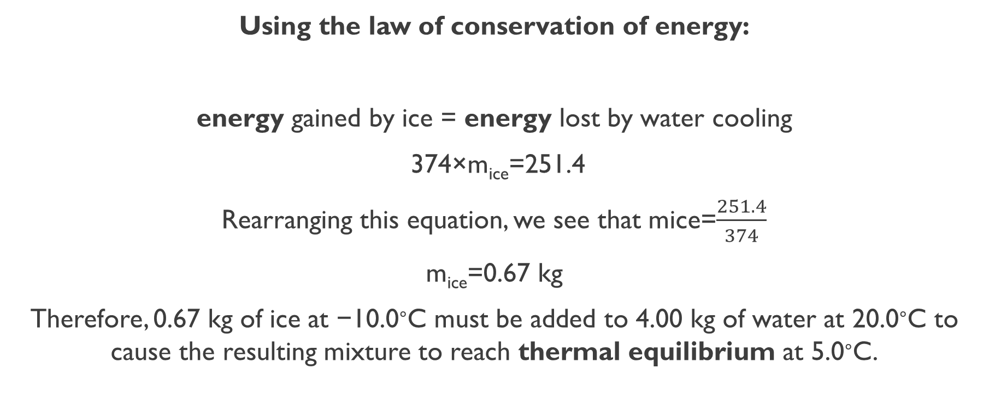
Calorimetry calculation example Continued
Using the law of conservation of energy:
energy gained by ice = energy lost by water cooling
374×m_{ice​}=251.4
Rearranging this equation, we see that mice​=$\frac{251.4}{374}$
m_{ice}​=0.67 kg
Therefore, 0.67 kg of ice at −10.0∘C must be added to 4.00 kg of water at 20.0∘C to cause the resulting mixture to reach thermal equilibrium at 5.0∘C.

Slide 62
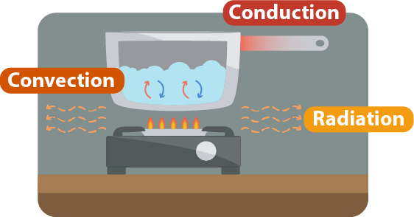
Energy transfers
You already know that energy cannot be created or destroyed, but it can be transferred or transformed.
If a system was perfect, then all energy would be simply changed from one form to another within the system. However, in reality, energy transfers and transformations in mechanical systems always result in some heat loss to the environment.
This can be due, for example, to friction or air drag as the components move. Some of the input energy is being converted to heat energy and lost from the system by conduction, convection or radiation.

Slide 63
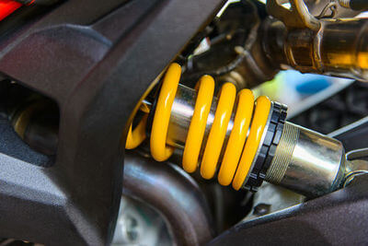
Types of Systems
An isolated system is a system which no energy or matter can enter or leave. The universe is the only true isolated system, but calorimeters are very close approximations of isolated systems. This is because calorimeters are highly insulated since they are used to measure heat in chemical reactions.
A closed system is a system where energy can enter or leave but matter remains in the system. Water and coolant in car engines is an example of a closed system.
An open system is a system which energy and matter can enter or leave. An example of an open system is the ocean.

Slide 64
High Grade or Low grade energy
High grade energy resources transform energy efficiently. Some examples are electrical energy, solar energy, and chemical energy.
Low grade energy resources transform energy inefficiently. The main low grade energy resource is heat.
Open systems always transform high grade energy resources into low grade energy resources.

Slide 65
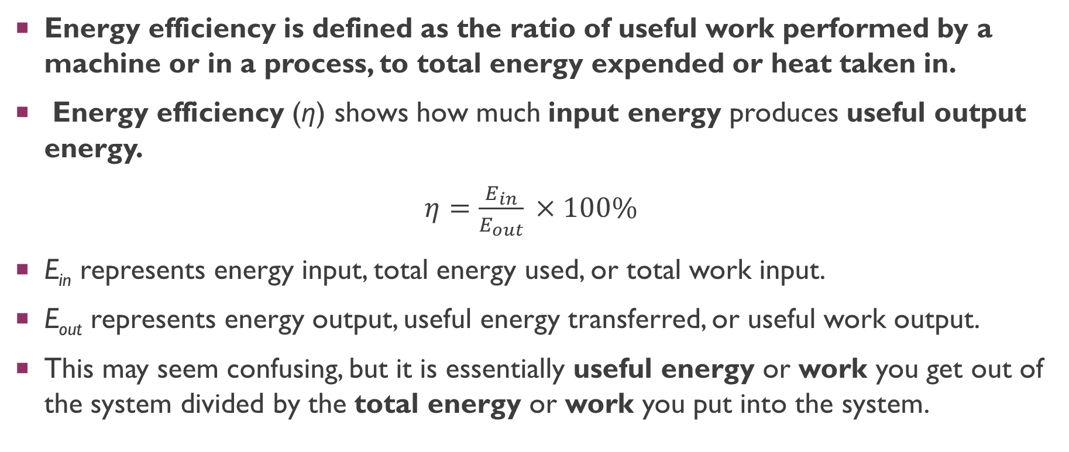
Energy Efficiency
Energy efficiency is defined as the ratio of useful work performed by a machine or in a process, to total energy expended or heat taken in.
Energy efficiency (η) shows how much input energy produces useful output energy.
$η=\frac{E_{in}}{E_{out}​}​​×100\%$
E_{in}​ represents energy input, total energy used, or total work input.
E_{out​} represents energy output, useful energy transferred, or useful work output.
This may seem confusing, but it is essentially useful energy or work you get out of the system divided by the total energy or work you put into the system.

Slide 66
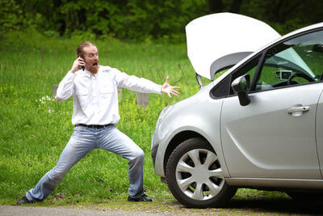
Energy efficiency explained
Energy efficiency can never be greater than 100%.
This is because the law of conservation of energy means that we can't get more energy out of a system than we put in.
Most systems are a lot less efficient than we might expect. For example, cars have an efficiency of η≈30%. Only around 30% of the chemical energy produced from fuel combustion is used to power the car. This might seem very low, and this is because cars produce a lot of heat and sound energy which makes them less efficient.

Slide 67
Questions
Nelson 1&2 Set 2.1 p 44
Nelson 1&2 Set 2.2 p 47
Nelson 1&2 Set 2.3 p 50
Nelson 1&2 Set 2.4 p 59
Nelson 1&2 Set 2.5 p 67
Nelson 1&2 Set 2.6 p 69

